Slide 1

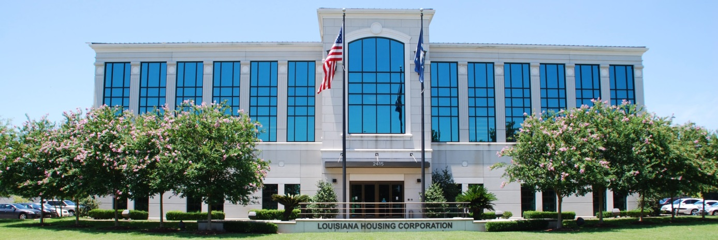





LOUISIANA
HOUSING CORPORATION
LHC Strategic Plan
Presented by
Kevin J. Delahoussaye
LHC Executive Director
LHC.LA.GOV
LouisianaHousingCorp @lahousingcorp Louisiana-Housing-Corporation @lahousingcorp
Notes:
Hello, my name is Breanne Bizette and I am the Public Information Officer for LHC.
I have been at LHC for more than over a year now, before I came to LHC I was a reporter and an anchor for the WAFB Channel 9 here in Baton Rouge. During my time there I received two regional Murrow Awards.
I am a graduate from Spring Hill College, where I received my bachelors degree in Communication Arts with a concentration in Journalism. When I attended Spring Hill College, I had to as explore other avenue besides Journalism as a part of the liberal arts education requirements. Therefore I learned about graphic design, videography and photography, public affairs, typography, and software.
I am very proud of my degree. I am able to utilize everything I learned and all of my talents, funneling it into promoting LHC as a state agency.

Slide 2

Current Strategic Planning
Housing Creation
Homeownership Opportunities
Agency Efficiency
Revenue Generation
Budget Optimization
Transparent Communications
Reporting & Analysis
Investment & Tracking

Slide 3

LHC’s Progression
Currently, LHC can report 88 pending developments in its pipeline which has a total of 7,300 units.
Homeownership loan production of $106,131,937 with 587 loans as of August 2025 (2% increase over 2024)
Departments have been streamlined and efficient processes put in place.
LHC’s Fee Schedule took effect on August 8, 2025 which updated fees for several aspects of the agency including compliance, single-family, multi-family, HOME, and asset management.
Executive and Leadership Teams worked with Accounting to optimize its budgets by reducing expenses and increasing potential revenue opportunities.
Detailed documentation is now presented in a consistent and transparent format.
Reports are now used for analysis and decision-making processes.
Funds are utilized as investment opportunities to generate additional revenue.

Slide 4

Future Planning
Expand housing creation opportunities
Increase pathways to homeownership
Prevent and reduce homelessness
Strengthen disaster recovery unit
Strengthen partnerships with local governments and rural communities
Expand and enhance rental assistance programs
Revenue generation & expense streamlining
Cross-training & employee development
Strengthen communications
Improve data systems

